Slide 1


Self-Supervised Learning for Speech Representations
Automatic Speech Processing, Master Cycle

Slide 2
Motivation
Speech datasets with transcriptions can be scarce / costly to create, depending on the task
Meanwhile, there is an abundance of unlabeled speech data
How can we benefit from unlabeled data?
→ Self-supervised Learning

Slide 3
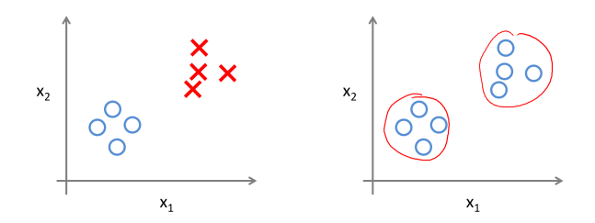
Supervised vs. Unsupervised Learning
Supervised
Learn from labeled examples
Unsupervised
Find structure in unlabeled data
Figure from https://lakshaysuri.wordpress.com/2017/03/19/machine-learning-supervised-vs-unsupervised-learning/

Slide 4
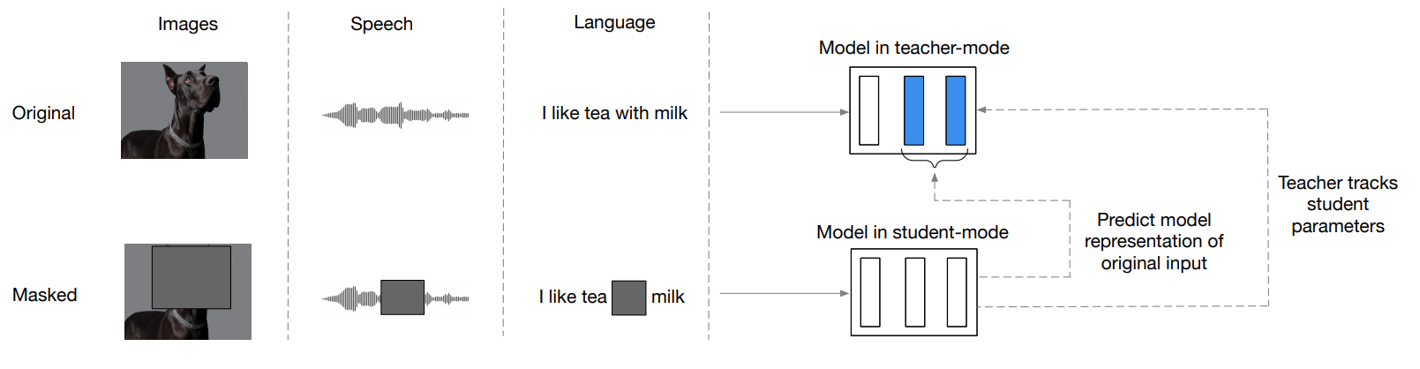
Self-Supervised Learning (SSL)
Data is still unlabeled but we design a pretext task to generate pseudo-labels.
A supervision signal is created from the unlabeled data itself
Goal: Learn useful speech representations which can perform well for a wide-range of downstream tasks
SSL Training
Fine-tuning on Downstream Task
Representation
Model
Representation
Model
"Angry"

Slide 5
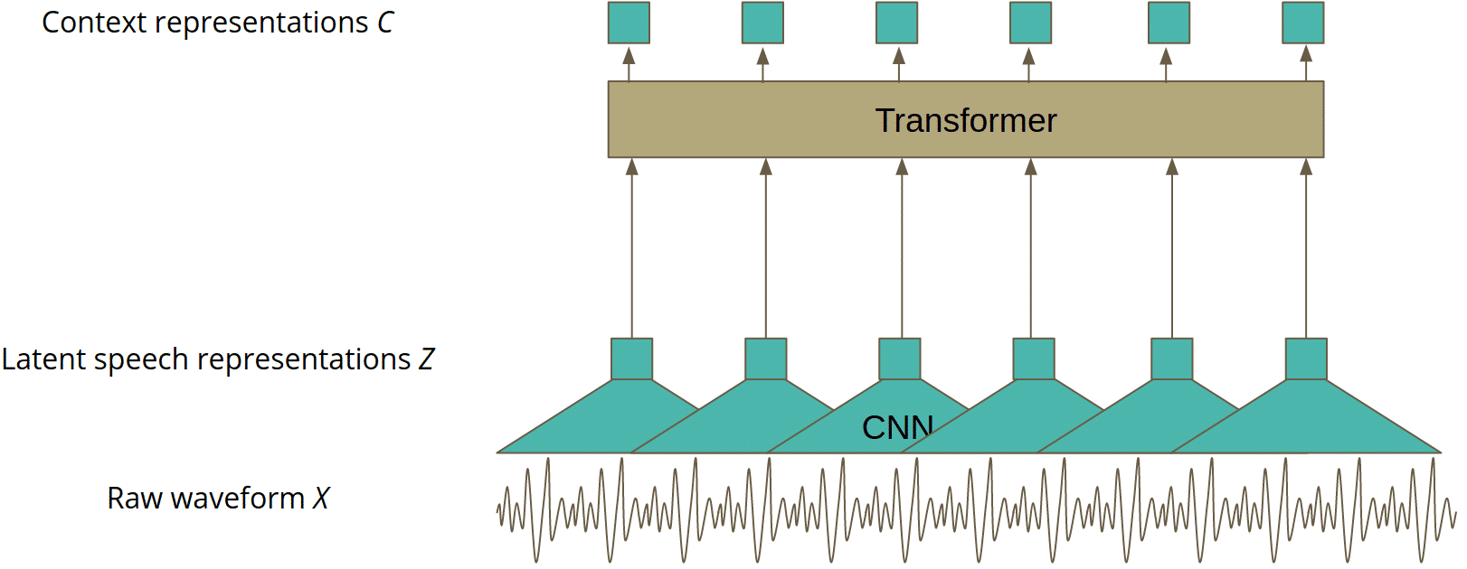
Typical Speech SSL Model Architecture
Figure from https://neurosys.com/blog/wav2vec-2-0-framework

Slide 6
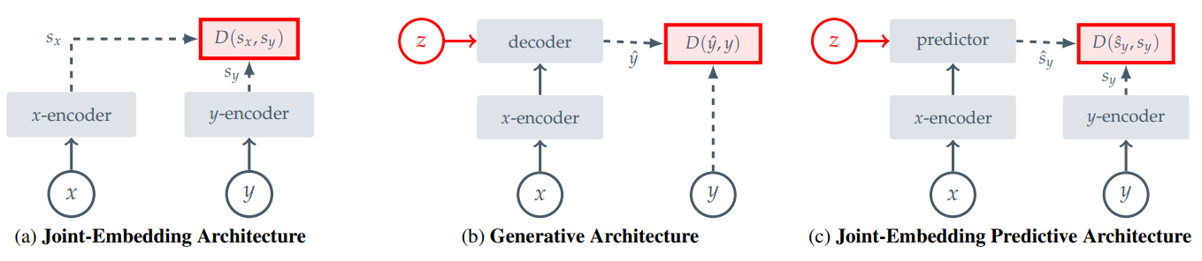
SSL Training Architectures
Assran, Mahmoud, et al. "Self-supervised learning from images with a joint-embedding predictive architecture." Proceedings of the IEEE/CVF Conference on Computer Vision and Pattern Recognition. 2023.

Slide 7
Generative Architecture
Learns to directly reconstruct a signal y from a compatible signal x
Decoder conditioned on additional variables z to facilitate reconstruction

Slide 8
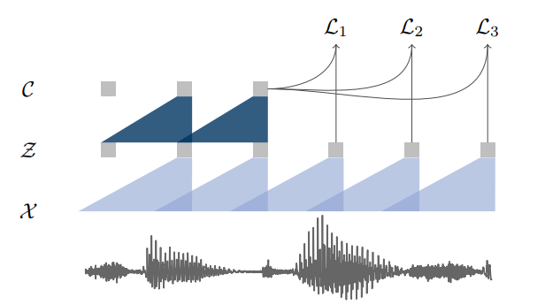
Generative Architecture
Wav2vec
Solves a next time-step prediction task
Predicts input features (raw audio encoded by the CNN encoder network)
Objective: Learns to distinguish a sample z_{i+k} that is k steps into the future from distractor samples drawn from a proposal distribution
Schneider, Steffen, et al. "wav2vec: Unsupervised pre-training for speech recognition." arXiv preprint arXiv:1904.05862 (2019).

Slide 9
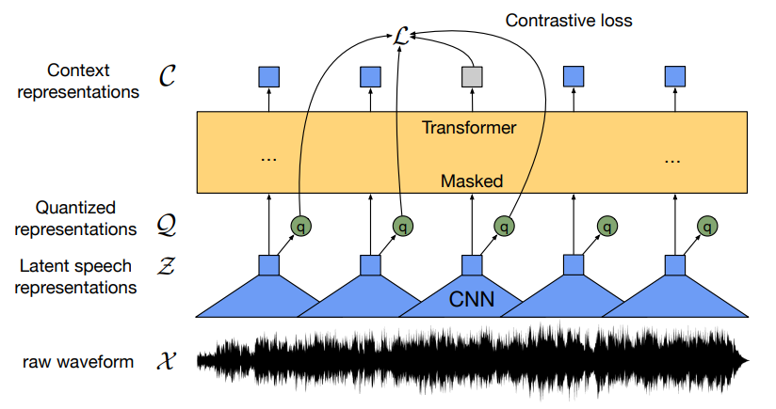
Generative Architecture
Wav2vec2.0
Solves a contrastive task defined over a quantization of the latent representations z
Masks the speech input in the latent space (CNN encoder output)
Objective: Learns to distinguish a true latent from distractors using quantized targets
Baevski, Alexei, et al. "wav2vec 2.0: A framework for self-supervised learning of speech representations." Advances in neural information processing systems 33 (2020): 12449-12460.

Slide 10
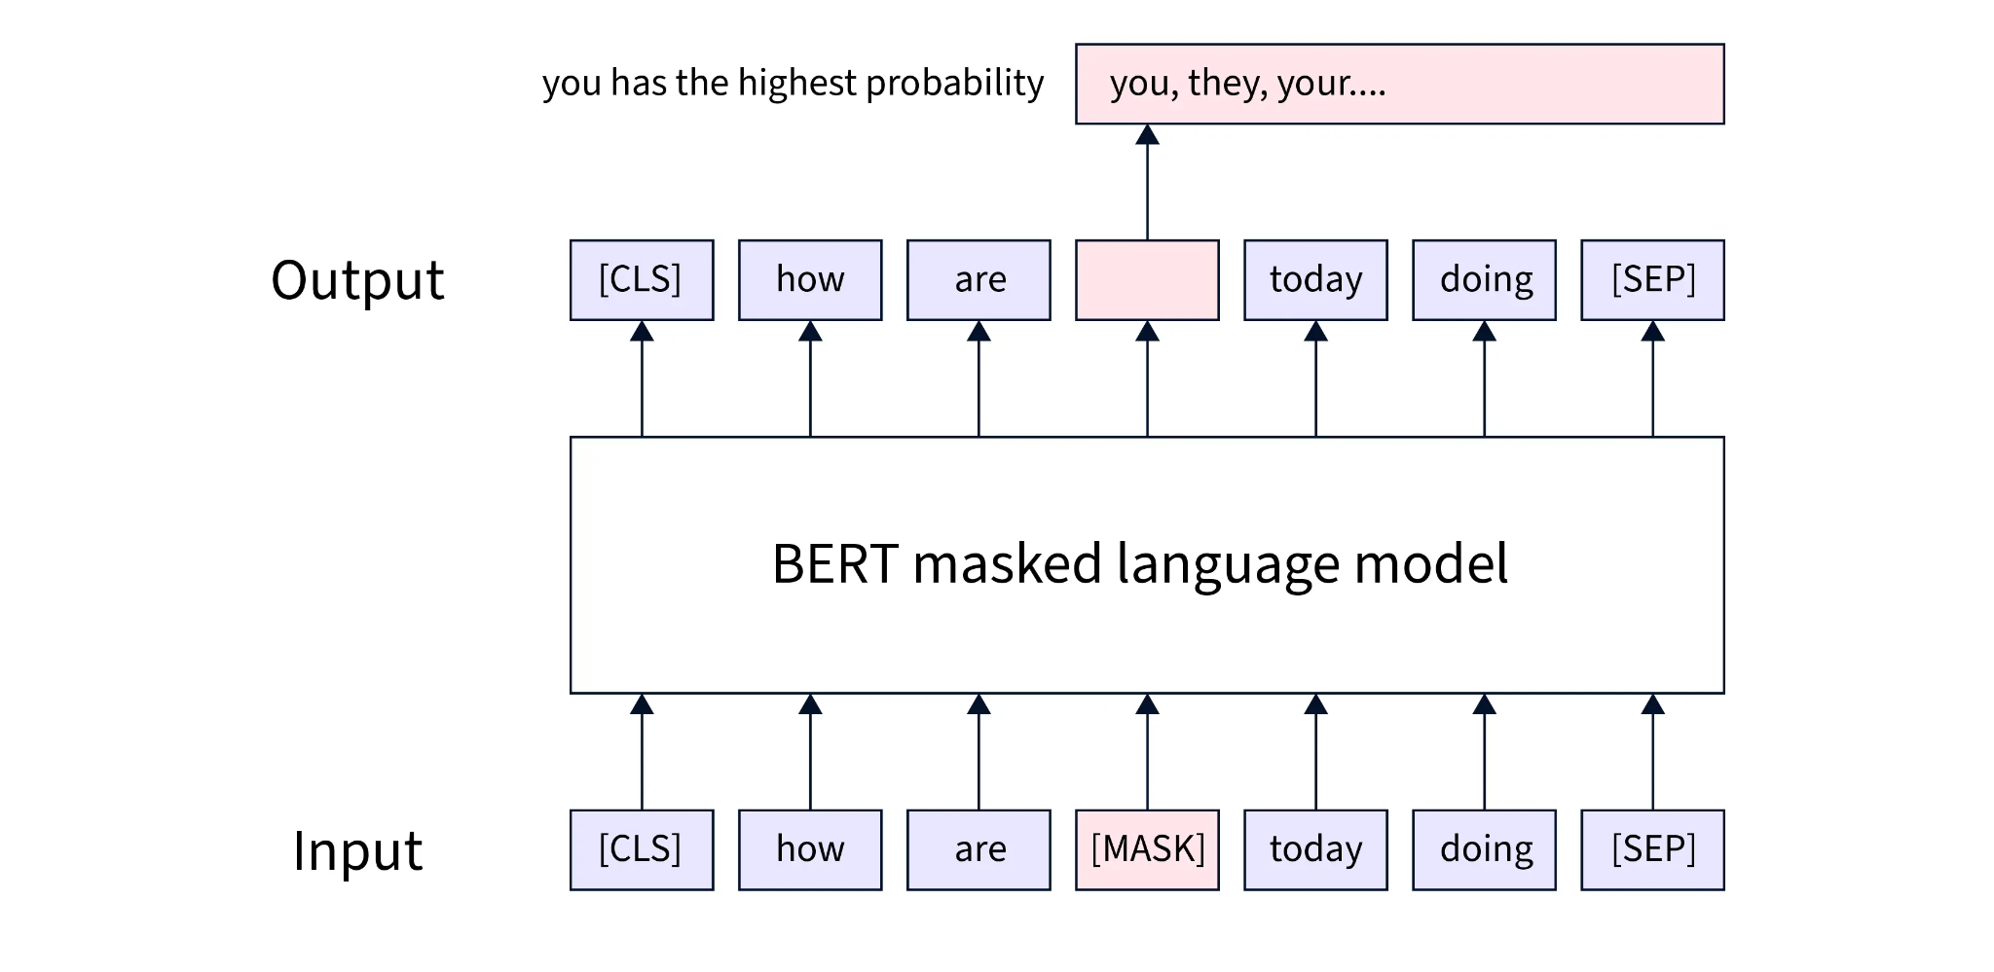
Generative Architecture
Bert (Text)
Figure from: https://www.scaler.com/topics/nlp/pre-training-bert/

Slide 11
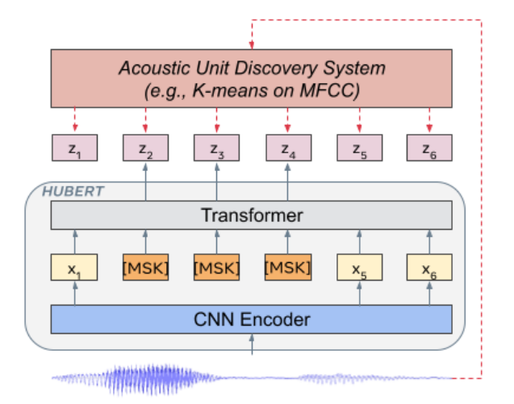
Generative Architecture
HuBERT
Uses offline clustering to provide aligned target labels for a BERT-like prediction loss
Prediction loss is applied over the masked regions only
Hsu, Wei-Ning, et al. "Hubert: Self-supervised speech representation learning by masked prediction of hidden units." IEEE/ACM transactions on audio, speech, and language processing 29 (2021): 3451-3460.

Slide 12
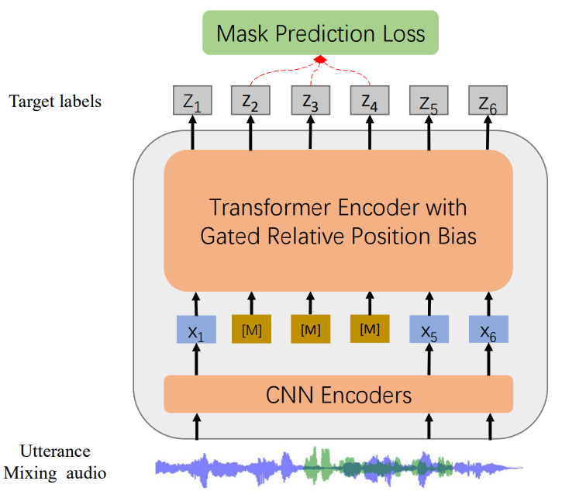
Generative Architecture
WavLM
Jointly learns masked speech prediction and denoising
Diversifies data sources for better generalization (vs. other models which are trained on podcast data only)
Chen, Sanyuan, et al. "Wavlm: Large-scale self-supervised pre-training for full stack speech processing." IEEE Journal of Selected Topics in Signal Processing 16.6 (2022): 1505-1518.

Slide 13
Joint-Embedding Architecture
Learns to output similar embeddings for compatible inputs x, y and dissimilar embeddings for incompatible inputs

Slide 14
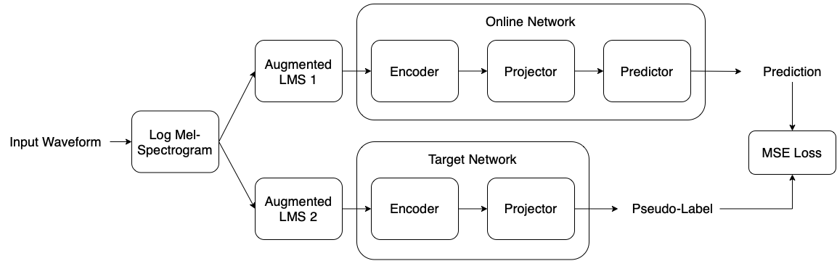
Joint-Embedding Architecture
BYOL
From an augmented view of an input waveform, we train the online network to predict the target network representation of the same image under a different augmented view
Elbanna, Gasser, et al. "Byol-s: Learning self-supervised speech representations by bootstrapping." HEAR: Holistic Evaluation of Audio Representations. PMLR, 2022.

Slide 15
Joint-Embedding Predictive Architecture
Learns to predict the embeddings of a signal y from a compatible signal x
Predictor conditioned on additional variables z to facilitate prediction

Slide 16
Joint-Embedding Predictive Architecture
Data2vec
Combines masked prediction with the learning of latent target representations
Teacher: builds representation of the full input data which serves as targets in the learning task
Student: encodes a masked version of the input sample with which we predict the full data representations
Baevski, Alexei, et al. "Data2vec: A general framework for self-supervised learning in speech, vision and language." International conference on machine learning. PMLR, 2022.

Slide 17
Why does SSL work?
Can make use of very large amounts of data
Transformer architecture is well suited to learn contextual information
Pre-text tasks allow learning representations that encode general information that is useful for a wide-range of tasks
For example, to predict what's missing, the model must grasp the structure of the data
→ The model builds rich internal representations

Slide 18
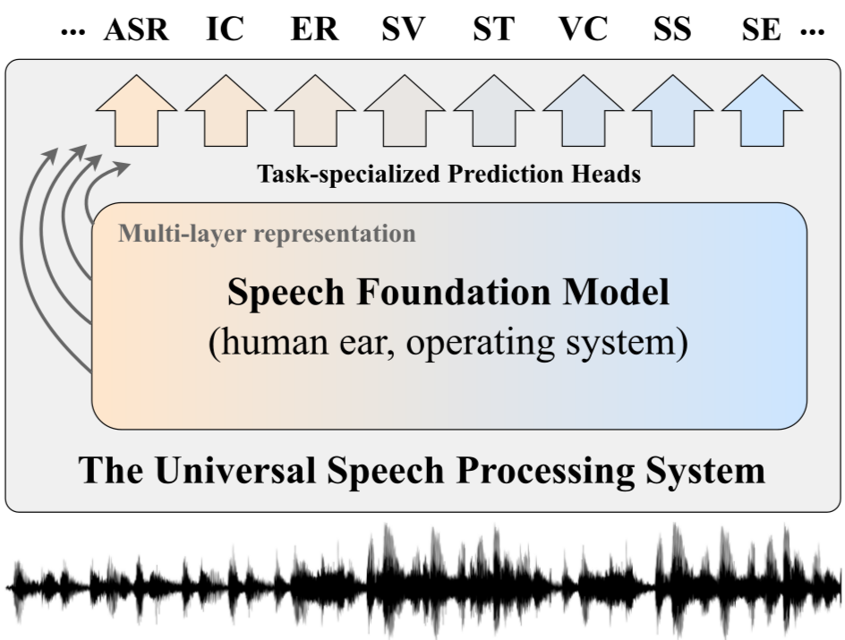
SSL Model Evaluation
Models are compared to each other by evaluating the representations across a wide variety of tasks
Benchmarks have been set up to perform this evaluation
Yang, Shu-wen, et al. "A large-scale evaluation of speech foundation models." IEEE/ACM Transactions on Audio, Speech, and Language Processing 32 (2024): 2884-2899.

Slide 19
SUPERB Benchmark
Category | Tasks
Content | Phoneme Recognition (PR), Automatic Speech Recognition (ASR), Out-of-Domain ASR (OOD-ASR), Keyword Spotting (KS), Query-by-Example (QbE)
Speaker | Speaker Identification (SID), Speaker Verification (SV), Speaker Diarization (SD)
Prosody | Emotion Recognition (ER)
Semantics | Intent Classification (IC), Slot Filling (SF), Speech Translation (ST)
Generation | Voice Conversion (VC), Source Separation (SS), Speech Enhancement (SE)
Yang, Shu-wen, et al. "A large-scale evaluation of speech foundation models." IEEE/ACM Transactions on Audio, Speech, and Language Processing 32 (2024): 2884-2899.

Slide 20
HEAR Benchmark
Category | Tasks
Speech | Speech Command Classification; Emotion Recognition; Language ID; Speaker Count
Music | Pitch Classification; Music Genre Classification; Music/Speech Classification; Music Transcription; Percussion Classification; Instrument Classification
Environmental / Other Audio | Office Sound Detection; Environmental Sound Classification; General Audio Tagging; Beehive Condition Classification; Gunshot Triangulation; Imitated Sound Type Classification
Turian, Joseph, et al. "Hear: Holistic evaluation of audio representations." NeurIPS 2021 Competitions and Demonstrations Track. PMLR, 2022.

Slide 21
Leaderboards
https://superbbenchmark.github.io/#/leaderboard
https://hearbenchmark.com/hear-leaderboard.html
Turian, Joseph, et al. "Hear: Holistic evaluation of audio representations." NeurIPS 2021 Competitions and Demonstrations Track. PMLR, 2022.

Slide 22
SSL for Synthesis
In a synthesis task, we generate new speech waveforms given inputs
Examples:
Voice
Conversion
Speech
(Speaker A)
Speech
(Speaker B)
Text-to-Speech
Text
Speech

Slide 23
Voice Conversion
Typical Pipeline:
Voice Converter
Speech (Speaker A)
Speech
(Speaker B)
Speech Encoder
Conversion
Model
Vocoder
Source Speech
Acoustic Features
Converted
Acoustic Features
Converted Speech

Slide 24

Copy-Synthesis
Speech Encoder
Vocoder
Source Speech
Acoustic Features
Decoded Speech
 | Features | Vocoders
Signal Processing-based Examples | Mel-spectrogram, MFCCs | Griffin-Lim, WORLD
Neural Examples | SSL Representations | HiFiGAN, BigVGAN

Slide 25
Voice Conversion
How can we leverage the strengths of SSL representations for voice conversion?
SSL models encode speech into a sequence of frames, each corresponding to a window of 25ms of speech, with a 20ms hop between windows.
Property: frames are linearly close if they contain similar phonetic, linguistic information, even if they are spoken by very different voices
Speech Encoder
Conversion
Model
Vocoder
Source Speech
Acoustic Features
Converted
Acoustic Features
Converted Speech

Slide 26
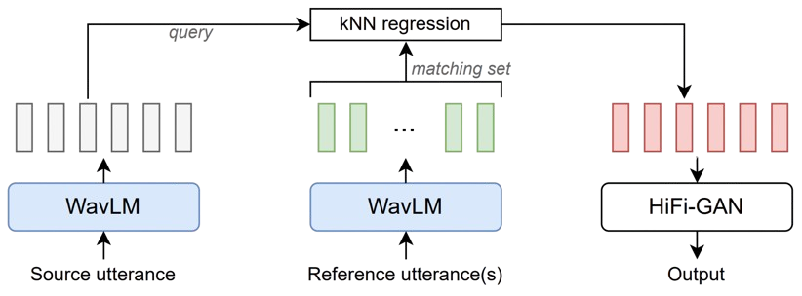
Voice Conversion: kNN-VC
Any-to-Any VC method
Leveraging self-supervised learning (SSL) features for zero-shot conversion
Requires no training
Source Target Converted
Baas, M., van Niekerk, B., Kamper, H. (2023) Voice Conversion With Just Nearest Neighbors. Proc. Interspeech 2023, 2053-2057

Slide 27
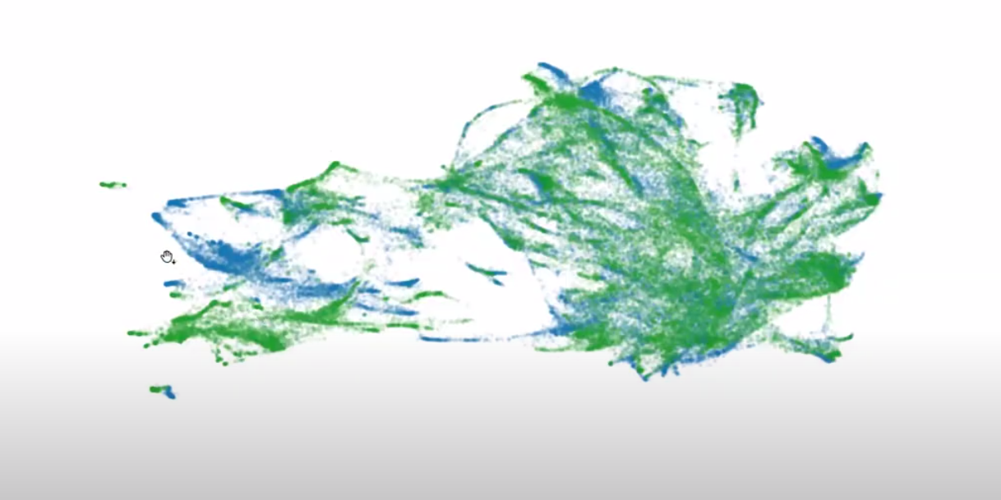
3D Projection of WavLM Features for Two Speakers
Notes:
Projection of WavLM features for two speakers (green & blue) in 3D space. We can observe that the features are close for the two speakers where the phonetic information is similar; there is shared structure. If they were coloured by phone, this would be clearly visible. The points to the left where they are different are silences.

Slide 28
Text-to-Speech
Typical Pipeline:
Text-to-Speech
Text
Speech
Text Encoder
Acoustic Model
Vocoder
Text
Linguistic Features
Acoustic Features
Speech

Slide 29
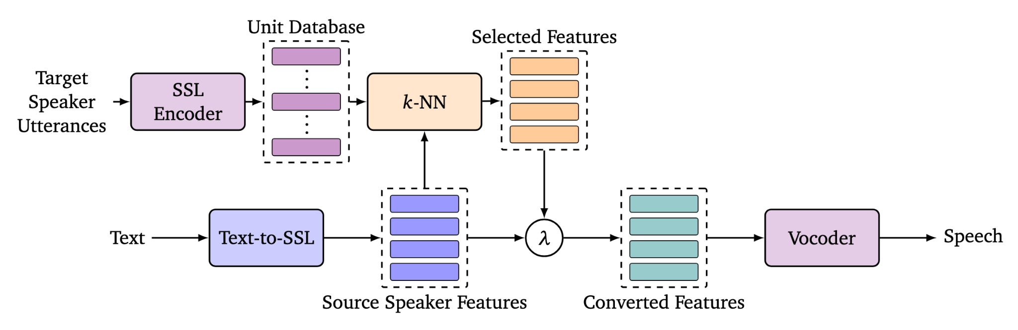

kNN-TTS
λ=0 | λ=0.5 | λ=1
Hajal, Karl El, et al. "kNN retrieval for simple and effective zero-shot multi-speaker text-to-speech." Proceedings of the Annual Conference of the Nations of the Americas Chapter of the Association for Computational Linguistics (NAACL) (2025).

Slide 30
Summary
Self-supervised learning enables learning useful general representations from unlabeled data
Evaluations show that SSL representations enable performance improvements for wide range of tasks;
→ Especially whenever labeled data is scarce
As seen in Voice Conversion for example, good representations can simplify task-specific models

